Slide 2
SCOPE
Who is a Chef?
Levels of
  Skill
  Professionalism
Attitudes in kitchen
Behaviour in Kitchen

Slide 3
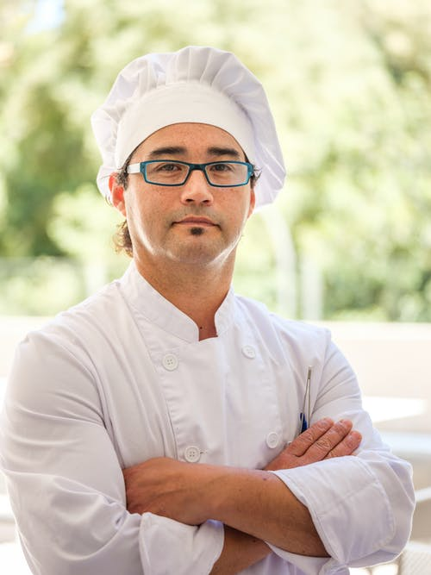
Who is a Chef
In French the term “CHEF” means Chief or Head. This term is fixed for the one who is In-Charge of the whole kitchen or a part of the kitchen.

Slide 4
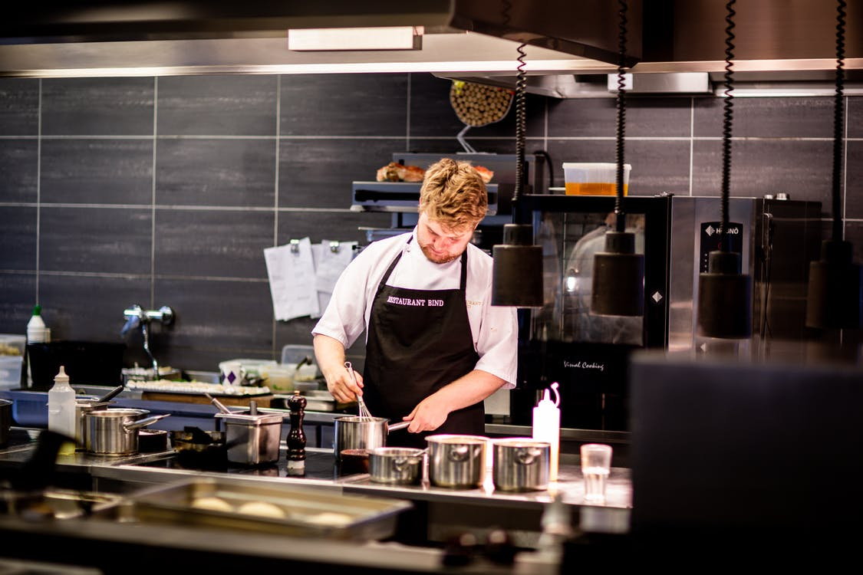
LEVELS OF SKILLS
The 3 Parameters
Job Level
Type of establishment
Type of food prepared

Slide 5
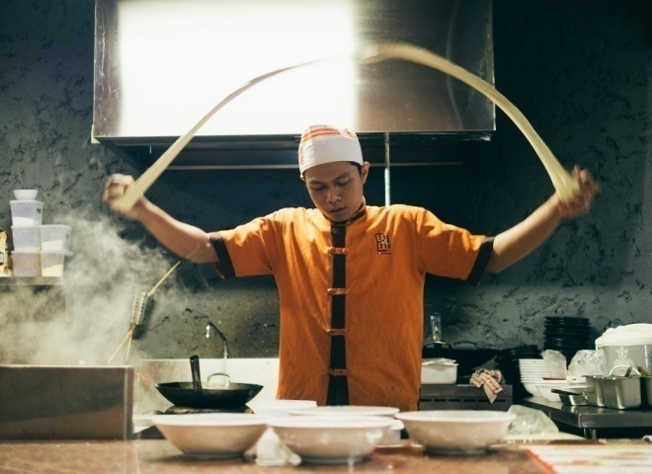
LEVELS OF SKILLS
Supervisory
Skilled & Technical
Entry level

Slide 6
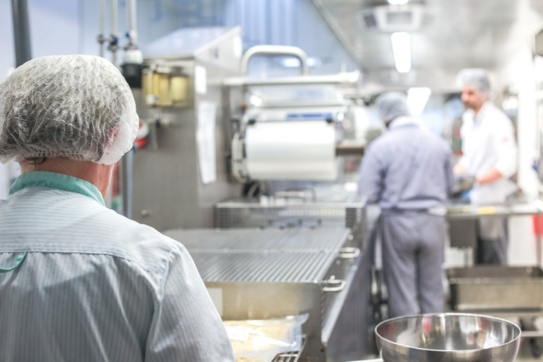
LEVELS OF SKILLS
Supervisory Executive Chef,
Head Chef,
Working
Chef, Dietary
Director
Skilled &
Technical Cook
Entry level No particular
skills required

Slide 7

SUPERVISORY SKILLS
Management & Supervisory Skills
Leadership quality
Thorough Knowledge of food production
Organizing & motivating people
Planning menus & Production Procedure
Controlling Costs and Managing budgets
Purchasing food Supplies and Equipment
Highly experienced cook to
      Schedule production
      Instruct workers & Control quality
Working with the brigade/people even under extreme
pressure

Slide 8
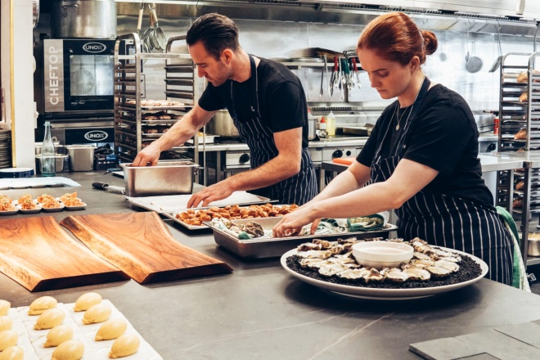
SKILLED & TECHNICAL
Knowledge & Experience in Cooking Techniques at least of dishes made in their own department.
Able to co-ordinate with other kitchen departments
Team work

Slide 9
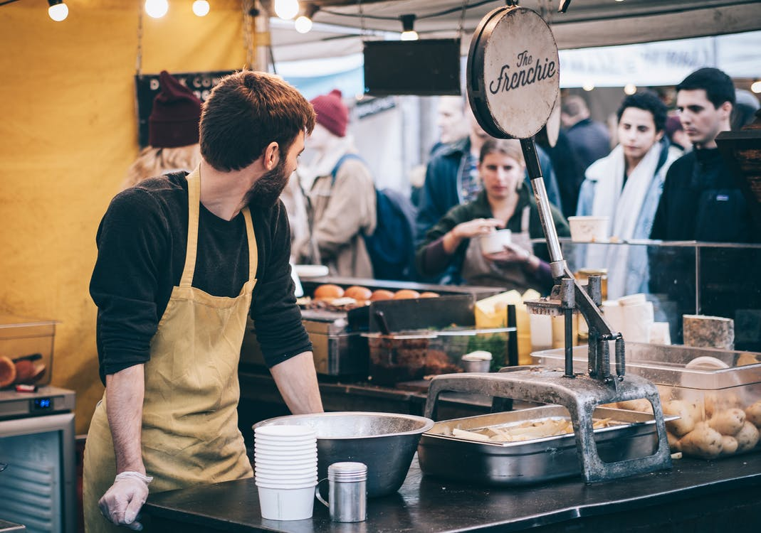
ENTRY LEVEL
No particular skills or experience required
Works assigned in the beginning-Washing vegetables & preparing salad greens.
As knowledge & experience is gained more complex tasks are assigned and they eventually become good cooks.

Slide 10
STANDARDS OF PROFESSIONALISM
1. Positive Attitude
2. Stamina-Staying Power
3. People Agile- Ability To Work With People
4. Lifelong Learner-Eagerness To Learn
5. Multi Skilled- A Full Range Of Skills
6. Experience
7. Perfection-dedication To Quality
Above Average Understanding Of The Basics Of
A Kitchen
9. Keen Believer In Maintenance Of Hygiene
10. Entrepreneurship

Slide 11
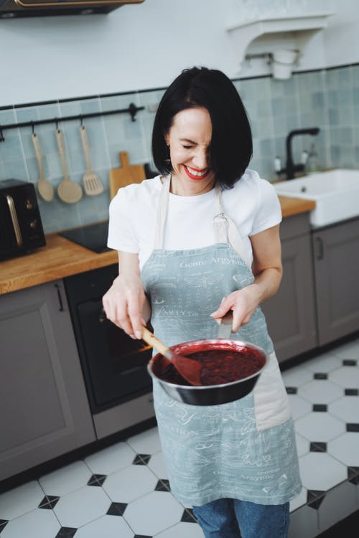
ATTITUDES IN KITCHEN
Positive Attitude
Eagerness to Learn
Taste & Commitment to preserve
Quality of food
Deep Knowledge of the basics of
kitchen
Rich experience
Physical & Mental agility with great
staying power
Team work
Wide range of cooking/technical
skills

Slide 12
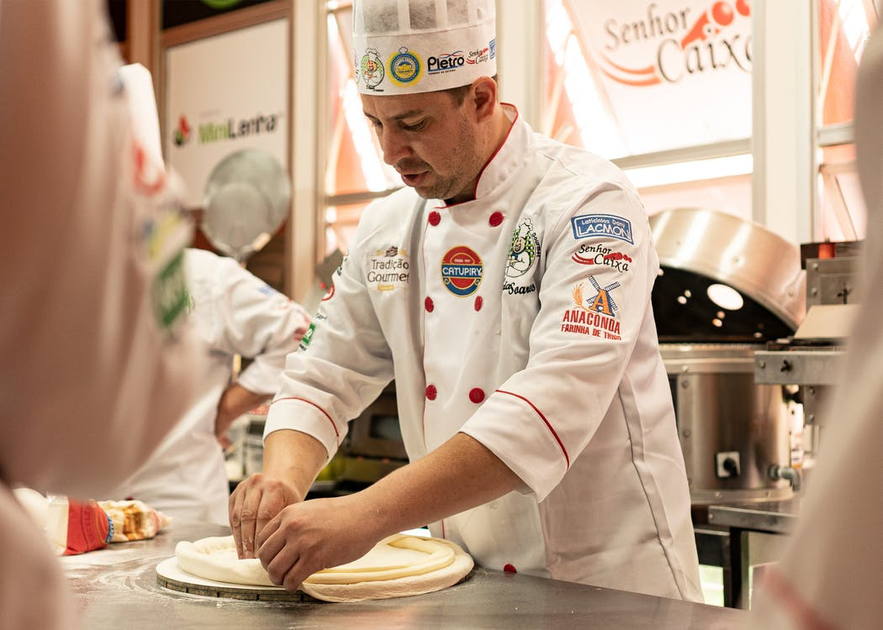
BEHAVIOUR IN KITCHEN
Punctuality
Sanitation & Hygiene
Politeness & Calmness
Understanding of safety
Polite language
Great Body language
Wearing neat & proper clothes
Taking briefing in time
Keeping the working tables always clean
Being Organized etc.

Slide 13
TASK
Divide The Class Into 4 Groups
1.Group_A-Supervisory Level
Write Skill Sets,Standard Of Professionalism ,Attitude & Behaviour Expected In Kitchen
2.Group_B-Skilled & Technical Level
Write Skill Sets,Standard Of Professionalism ,Attitude & Behaviour Expected In Kitchen
3.Group_C-Entry Level-
Write Skill Sets,Standard Of Professionalism ,Attitude & Behaviour Expected In Kitchen
4.GROUP_D_The Judges-
Compare And Contrast The Work Of Other Three After They Explain The Work. Announce The Winner Of The Task Giving Exact Reasons.

