Slide 2
SCOPE
Cross-Contamination
Personal Hygiene

Slide 3
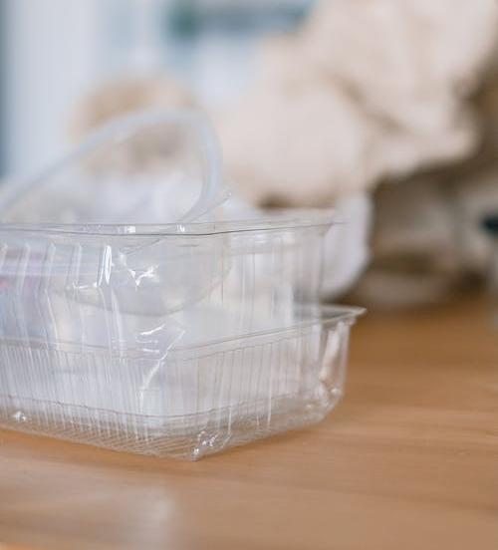
CROSS-CONTAMINATION
Cross Contamination is the basic reason, for the spoilage of food.When an otherwise safe food is loaded with harmful substances mainly micro-organisms due to coming in contact with unsafe food/surface such as equipments,worktables or hands,it is termed as Cross-Contamination.

Slide 4
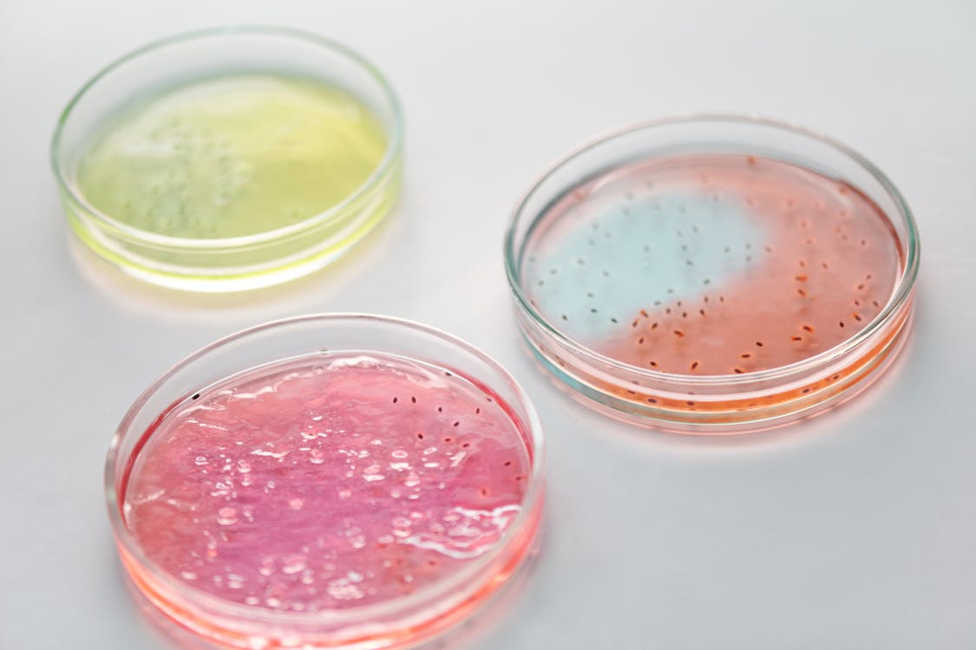
Why Personal Hygiene?
Most food borne diseases are spread by the unhygienic practices adopted by food handlers.

Slide 5
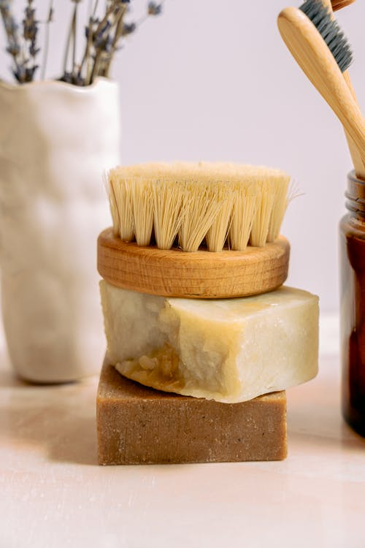
Personal Hygiene
Diseases
Bathing
Brushing
Moustache/Beards
Hair
Dress
Hands
Shoes
Nails
Others

Slide 6
Personal Hygiene
Diseases Do not work if suffering with communicable diseases
Bathing Bath daily.Twice if Possible
Brushing Twice daily
Moustache/Beards Clean Shaven,Better otherwise properly trimmed & Maintained
Hair Properly trimmed,combed & wear hairnets when handling food

Slide 7
Personal Hygiene
Moustache/Beards Clean Shaven,Better otherwise properly trimmed & Maintained
Hair Properly trimmed,combed & wear hairnets when handling food
Nails Keep your nails always
trimmed. Do not wear nail paint.

Slide 8
Personal Hygiene
Dress Washed,neat & Clean, well- ironed,should be well fitting
Shoes Should be oxford,comfortable,of proper size and should not bite the toes

Slide 9
Personal Hygiene-Hands
Wash your hands and exposed part of your arms
before and during work,including
    After eating, drinking & smoking.
    After using washroom.
    If you touch anything which may be
    contaminated with bacteria.
    After coughing and sneezing .

Slide 10
Personal Hygiene-Others
Smoking, eating or chewing , ☒
during handling of food
Keep cuts and sores covered ☑
with bandage.
Sitting on worktables. ☒
Use gloves, tongs, pluckers &
other plating & serving gears ☑
to keep the hand touch minimal
on food.

Slide 11
TASK
Divide The Class Into 4 Groups
1.Group_A-IMPORTANCE OF PERSONAL HYGIENE IN KITCHEN
Write & Explain to the class
2.Group_B-HAND HYGIENE IN KITCHEN
Write & Explain to the class
3.Group_C-HYGIENIC ETIQUETTES IN KITCHEN
Write & Explain to the class
4.GROUP_D_STANDARDS OF HYGIENE OF HAIRS,DRESS,NAILS,BEARDS,MOUSTACHE,SHOES
Write & Explain to the class

