Slide 2
SCOPE
Selection Of an Egg
      How to Check freshness
      Storage
      Diseases
Uses of Eggs in food production
Egg preparation

Slide 3
SELECTION OF AN EGG
The egg shell should be cleaned well shaped long and slightly rough.
When eggs are broken there should be a high proportion of thick white to thin white. If an egg is kept the thick white gradually changes into their white and water passes from the White into the Yolk.
Yolk should be firm, round (not flattened) and of a good even colour. As eggs are kept the Yolk loses strength and begins to flatten, water evaporates from the egg and is replaced by air.
Eggs in the Shell should be free from cracks, leaking and obvious wholes.
All eggs in the Shell should be free from cracks ,leaking and obvious holes

Slide 4
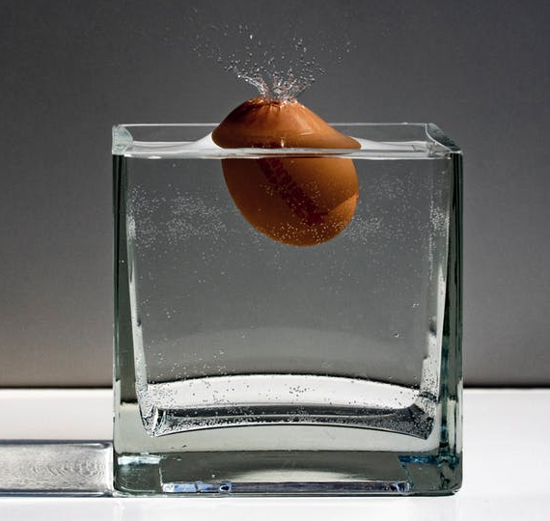
HOW TO CHECK FRESHNESS OF AN EGG?
A fresh egg is heavy and should feel well filled and loses a tiny fraction of water through the porous shell.
It is easy to test the freshness of an egg by plunging it into salted water
    An egg up to three days old will fall at once to the bottom.
    An egg 3 to 6 days old will float Halfway up the water.
    If it is bad it floats horizontally on top of the water.

Slide 5
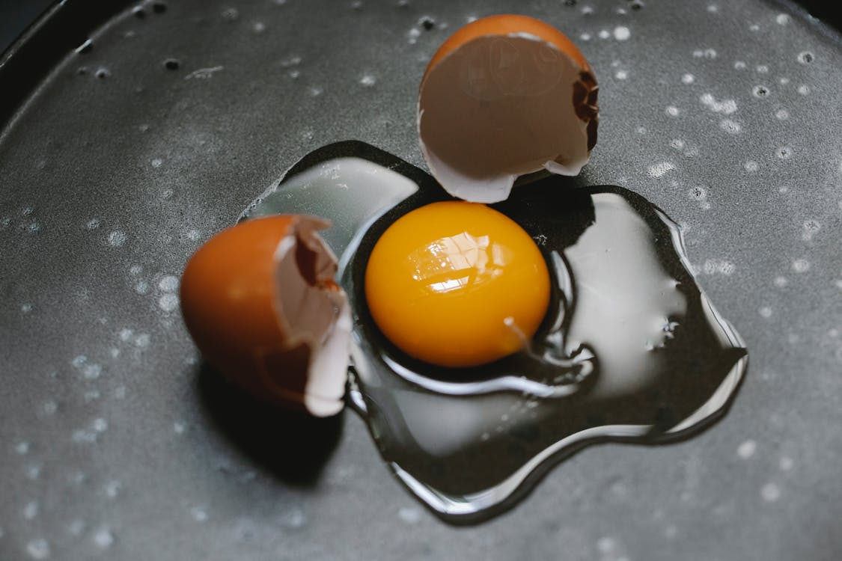
HOW TO CHECK FRESHNESS OF AN EGG?
2. Another method is to break the egg into a plate.
    If the Yolk is compact and positioned in the centre of the egg is fresh.
    If the egg is 1 week old the Yolk is not in the centre.
    In the at that is 2-3 weeks old the Yolk has a tendency to spread.

Slide 6
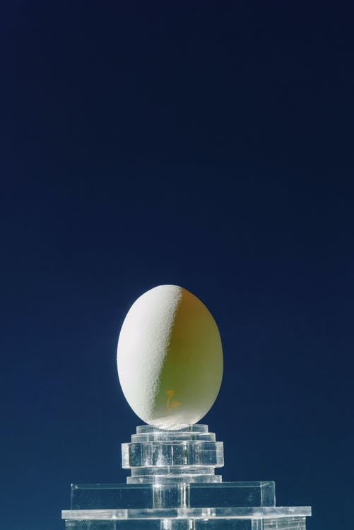
HOW TO CHECK FRESHNESS OF AN EGG?
3. The freshness of an egg can also be tested by holding it up to light a very small air chamber indicates a very fresh egg.

Slide 7
STORAGE OF AN EGG
Egg whole in shell 5 to 7 days 33 -38 F /1-3 C
Eggs whole Fluids 2 to 3 days 29-32 F/ - 1 to 0 C
Eggs frozen 1 to 2 months -10 to 0 F/-23 to -18 C
Eggs Dried 1- 2 months -4 to 0 F/4 C

Slide 8
STORAGE OF AN EGG
POINTS TO BE NOTED
Fresh eggs should be used within a month and stored and washed with the pointed and down in the least cold part of the refrigerator.
The egg and the egg shell are permeable to Smells.
Hard- boiled egg will keep for four days unshelled two days, if shelled.
Hard- boiled egg pickle in flavored vinegar and sterilized will keep for months.

Slide 9
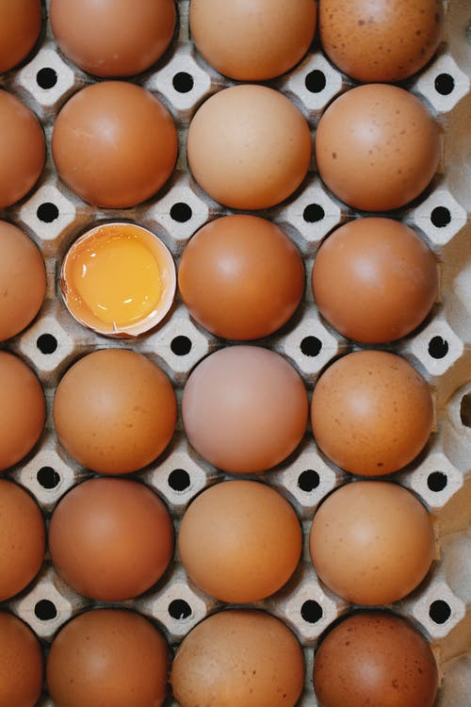
STORAGE OF AN EGG
POINTS TO BE NOTED
A raw egg yolk will keep for 24 hours.
A raw egg white will keep for 6 to 12 hours.
Dessert containing raw eggs should be eaten within 24 hours.
Fresh eggs can be frozen if they are broken into a bowl and poured into suitable containers.

Slide 10
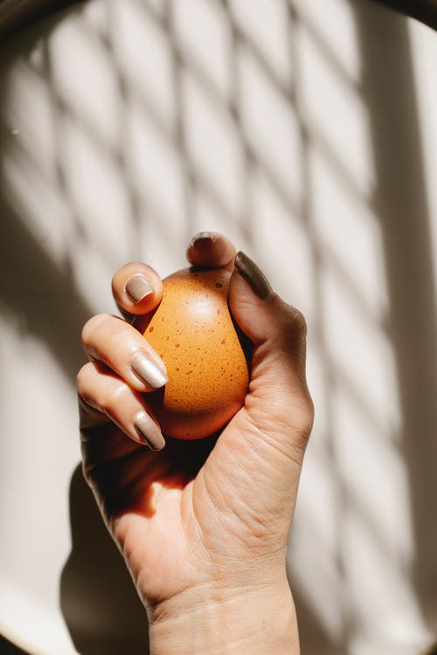
EGGS AND DISEASES
Raw egg yolks are a potentially hazardous food due to the possible presence of salmonella bacteria Salmonella bacteria are killed when the egg are held at a temperature of at least 60 degree centigrade for for minimum of three and half minutes the bacteria is also killed instantly at 71 degrees fried egg .Poached eggs should be served only at customer request

Slide 11
USES OF EGG IN FOOD PRODUCTION
In kitchen they have innumerable uses,they serve as:
1. Binding agent
2. Coating agent
3. Leavening agent
4. Emulsification
5. Glazing- Enhances Colour and Sheen
6. In force meats
7. Enriches and enhances flavour and taste
8. Thickening agent
9. Decoration and garnishing of dishes
10.Clarifying agent

Slide 12
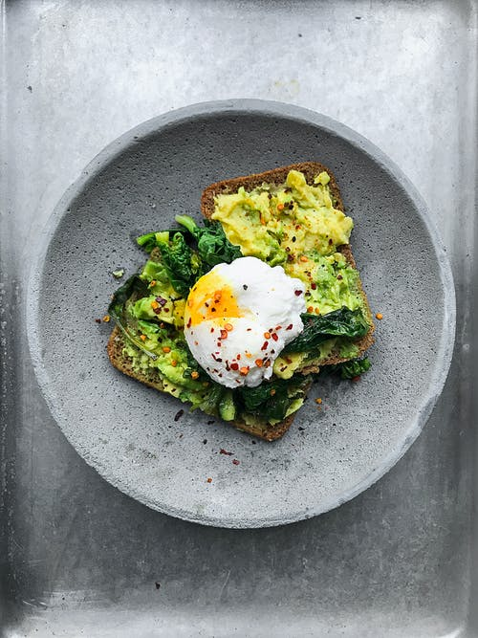
EGG PREPARATIONS
Eggs a la coque Boiled Eggs
Eggs En Cocotte Eggs cooked in individual dishes
in a bain marie in the oven.
Eggs Sur le Plat Shirred eggs-Eggs cooked in a
pan or in individual dishes in a
cool oven.
Fried Eggs Sunny side up or down
Hard Boiled Eggs
Omelletes Plain,Stuffed
Poached Eggs
Scrambled Eggs
Soft Boiled Eggs etc.

