Slide 2
SCOPE
Introduction
Definition
Structure of An Egg
Whole Egg,Egg White & Egg Yolk

Slide 3
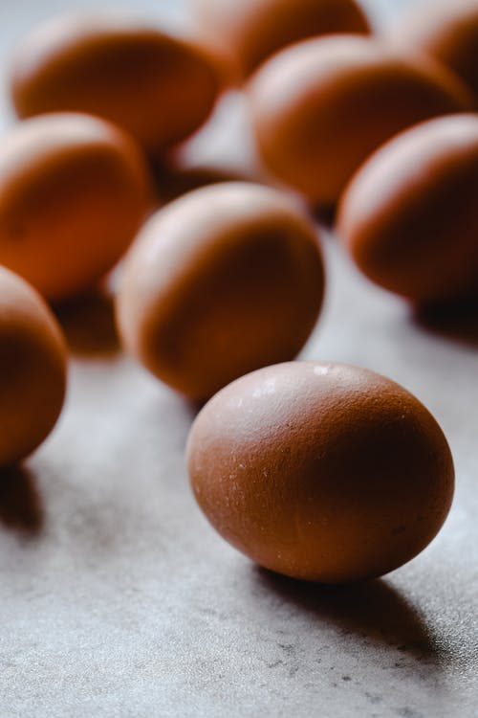
INTRODUCTION
Eggs are one of the kitchens most important items.
From mayonnaise to meringues, soups to sauces, appetizers to desserts they are prominent on any menu.
Eggs are useful as main dish as they are protective food .
They provide nutrients for energy, growth and repair of our body.

Slide 4
INTRODUCTION
Although the eggs of many birds fish and even reptiles can be used as food the word at an qualified applies exclusively to hens egg .
All other types of egg offered for sale must be labeled appropriately –quail’s egg, duck’s egg etc.
There are also exotic varieties such as crocodile or ostrich eggs.

Slide 5
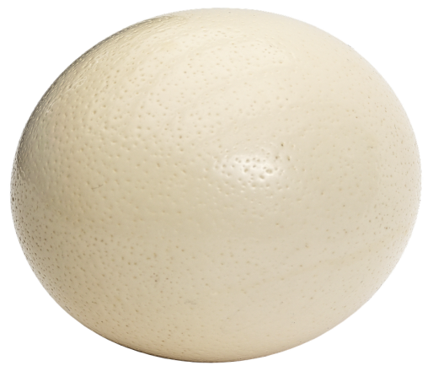
DEFINITION
The round or oval reproductive body laid by the female of many animals containing the developing embryo and its food reserves ,protected by a shell or skin.

Slide 6
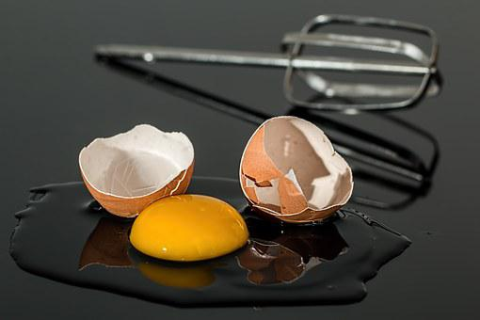
WHOLE EGG,EGG WHITE & EGG YOLK
Weight-approx 60gm
Egg Shell is 12% of total weight of egg.
Egg shell is made of calcareous porous
substance which is pervious to air, water
and smells.
Egg shell is lined with the delicate
pellucid membrane which separates itself
from the shell at the larger end of the
egg to form the air chamber. The size of
this chamber is an inverse proportion to
the freshness of the egg- the fresher the
egg , smaller the chamber.
WHOLE EGG

Slide 7
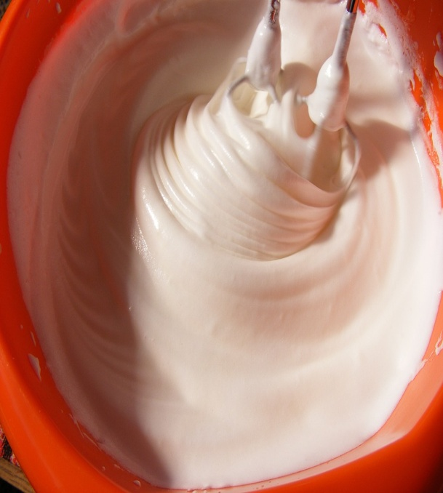
STRUCTURE OF AN EGG
The albumin or the white of the egg is thick viscous, transparent liquid containing half the protein content of the egg.
It also has a high percentage of water and some mineral substances.
Albumin is soluble in cold water.
It coagulates at 70 degree centigrade or 158 Fahrenheit and remains from then on insoluble.
It forms about 55% of the total weight of egg .
EGG WHITE

Slide 8
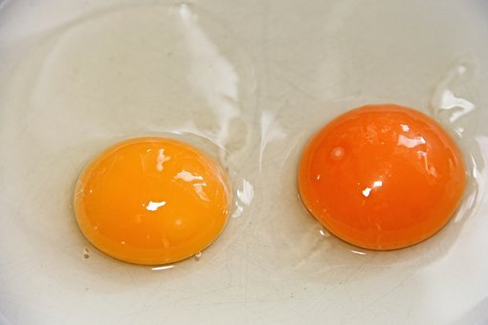
WHOLE EGG,EGG WHITE AND EGG YOLK
Yolk of the egg is 30% of the total weight.
It is an obaque substance which coagulates on heating
The Yolk is composed of albumin, fat containing vitamins, lecithins, nucliens, chlorestins and mineral substances including a ferruginous pigment called haematogen., which gives it its colour.
It contains germs( visible in fertilized egg -this does not mean the egg is inedible),the remaining protein
and all the fats especially lecithin , together with iron ,sulphur and vitamins ABDE.
EGG YOLK

Slide 9
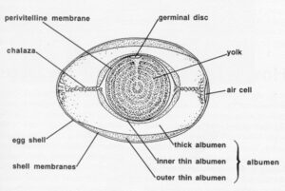
STRUCTURE OF AN EGG

